Slide 1
PREDICTING CUSTOMER BUYING BEHAVIOR
British Airway
Ola Suaifan

Slide 2
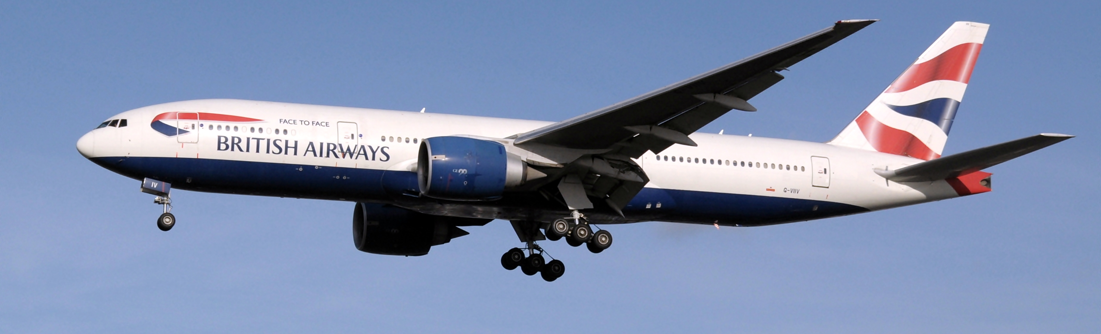
OVERVIEW
Consumers now wield more influence, thanks to the abundance of accessible information, altering the traditional buying journey. Airlines must adopt a proactive approach to attract customers before their travel plans materialize, leveraging data and predictive models.
This presentation will demonstrate the construction of a predictive model using customer booking data to anticipate their purchasing patterns.

Slide 3
Introduction
Explore and prepare the dataset
Train a machine learning model
Evaluate model and present findings

Slide 4
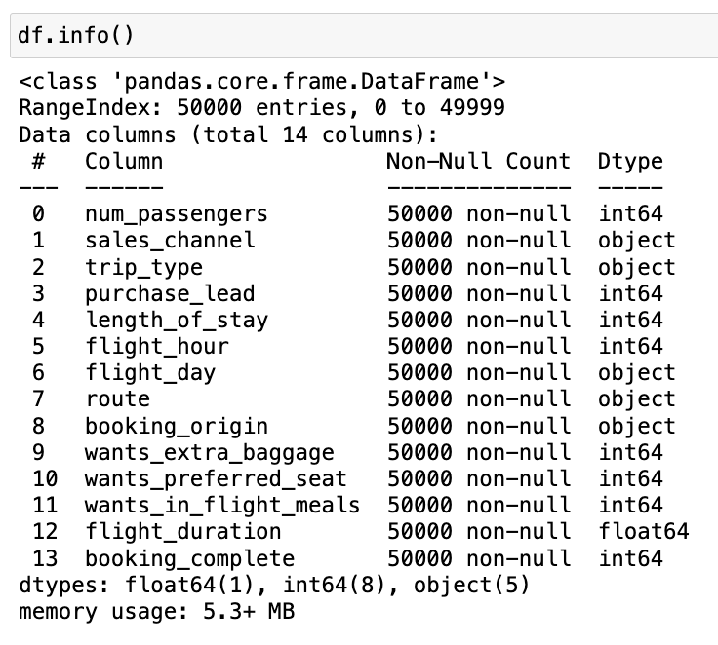
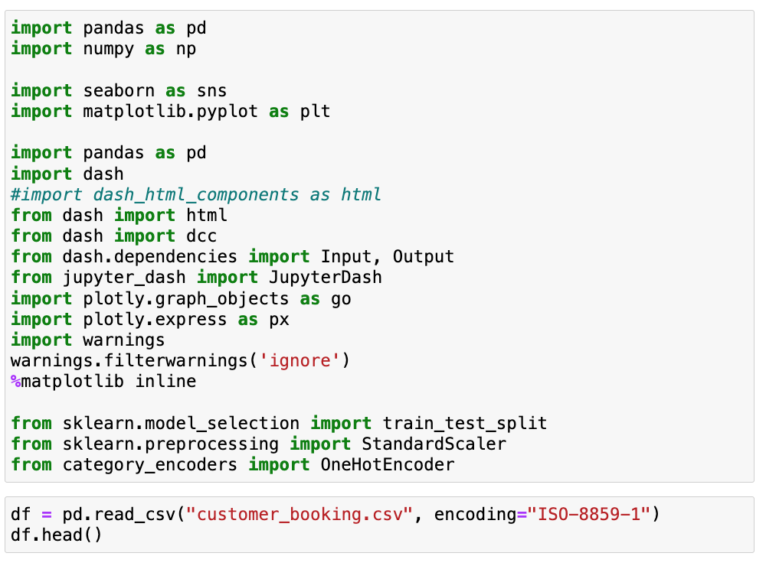
LIBRARIES AND DATASET LOADING

Slide 5
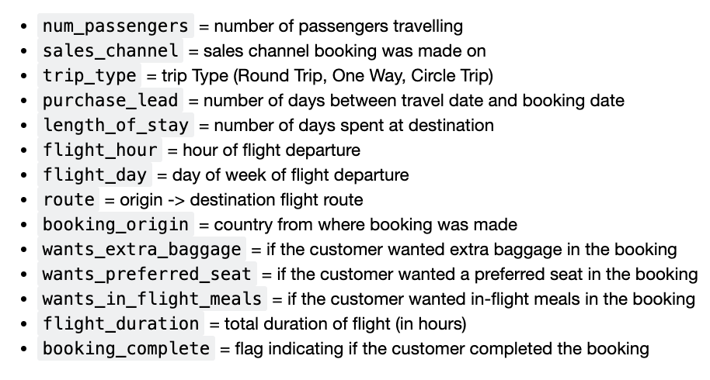
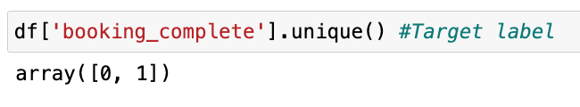
DATASET
There are 13 features with different data types (categorical, Numerical, Ordinal).
The target label column is the “booking_complete”.
The dataset will be trained to see the customers booking behavior.

Slide 6
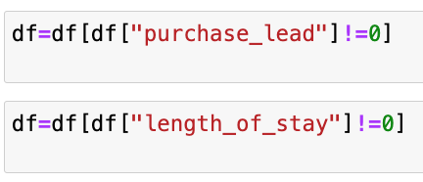
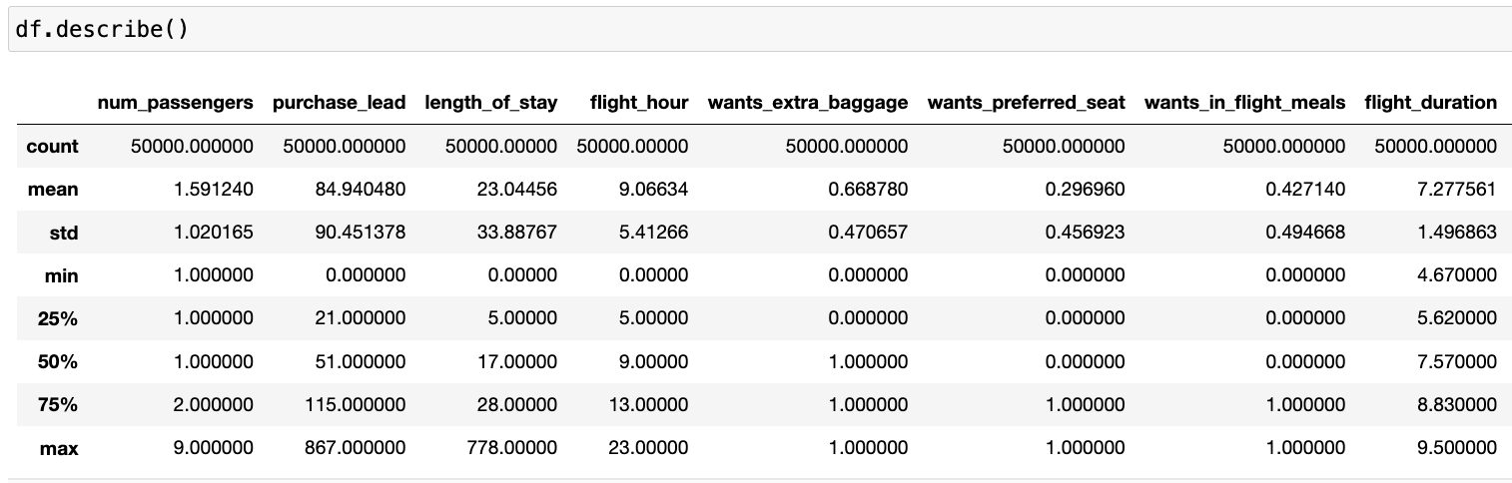
Data Preprocessing
wrong entries were dropped from the purchase lead and length of stay.

Slide 7
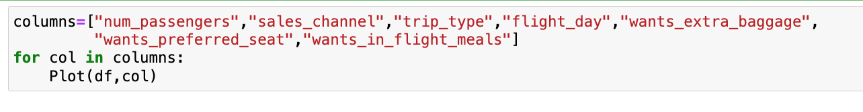
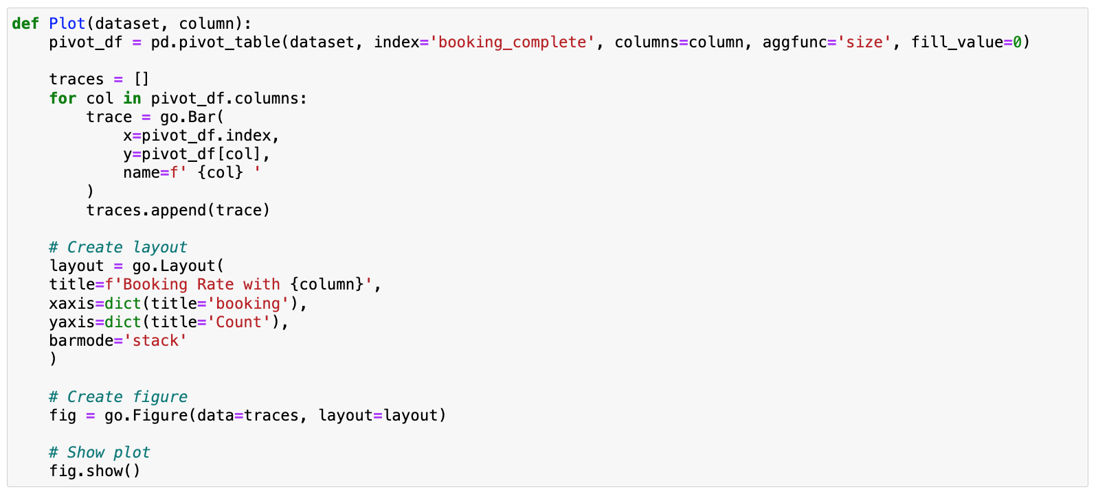
STATISTICAL SUMMARY
The Features were summarized towards the booking behavior as in the next slides.

Slide 8
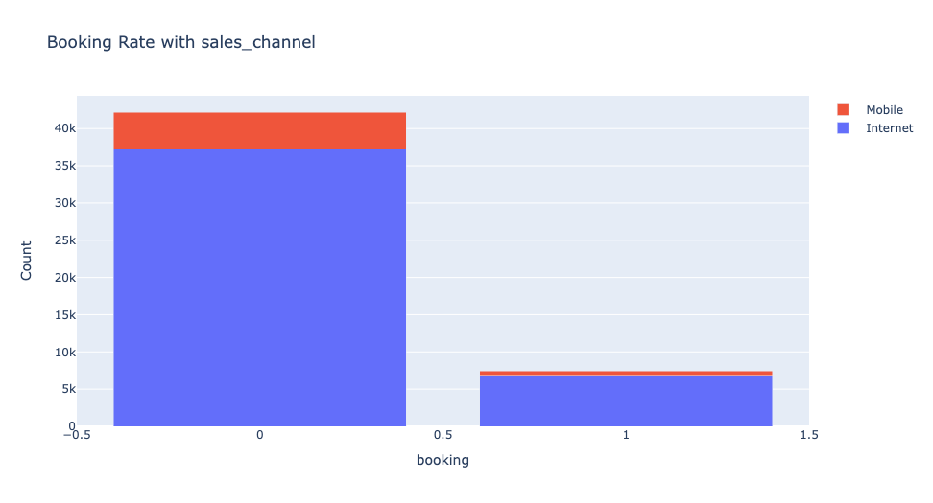
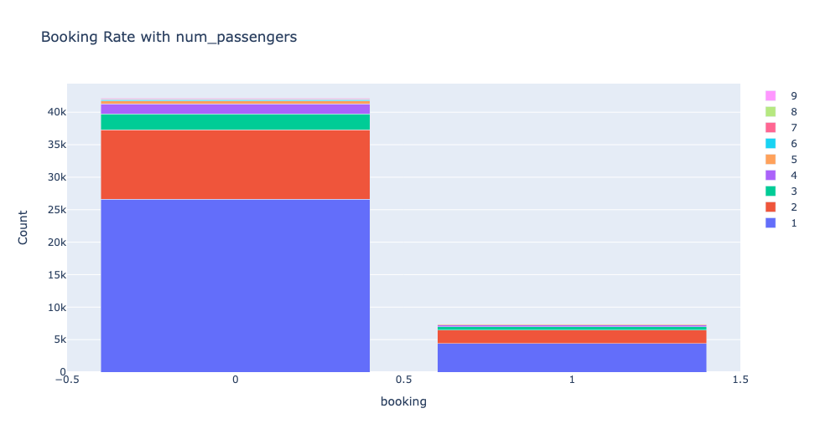
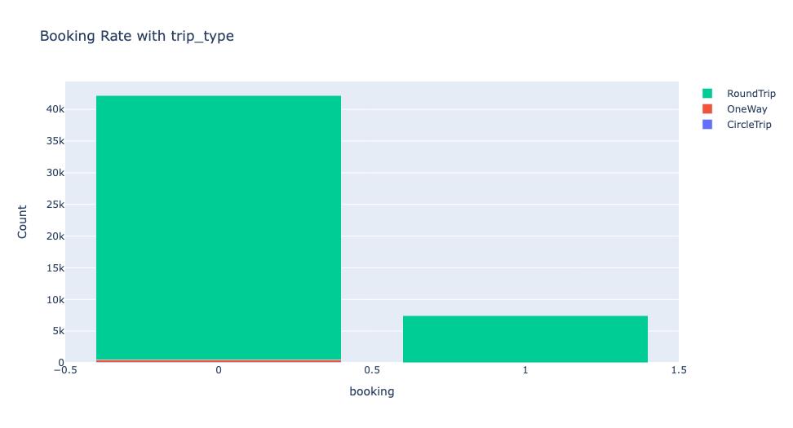
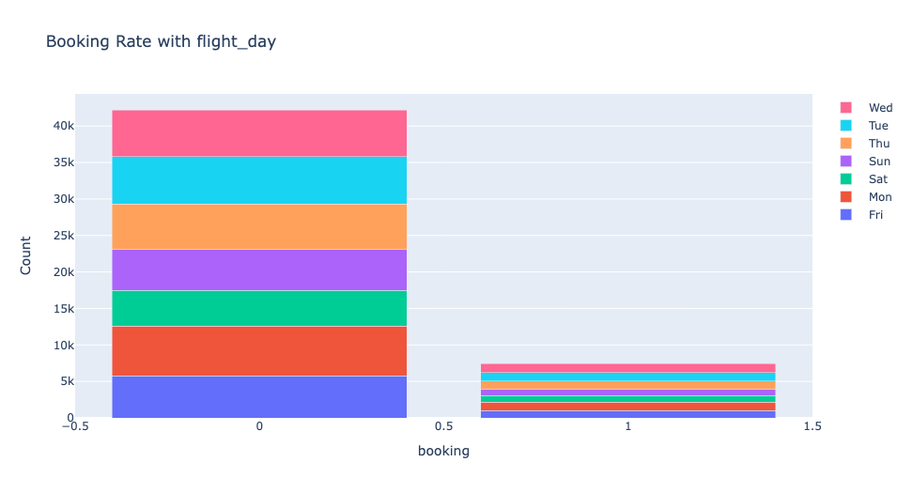
STATISTICAL SUMMARY
Insights:
The majority of customers didn’t complete the booking
Most of the customers booked through the internet.
The most frequent category in number of passengers is ”1” then ”2”.
Most of the customers chose round trips.
There were flights evenly every weekday.

Slide 9
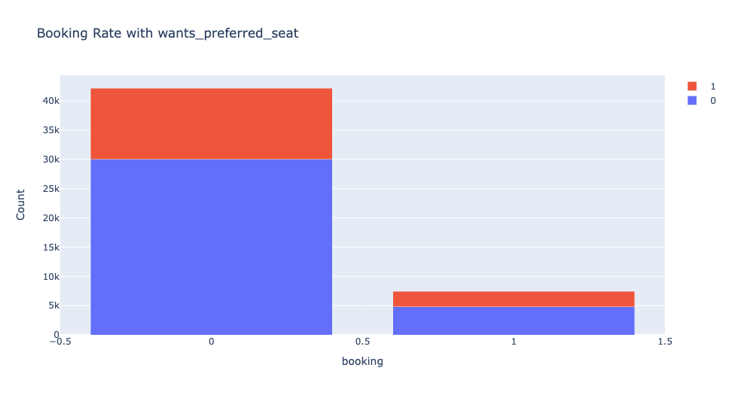
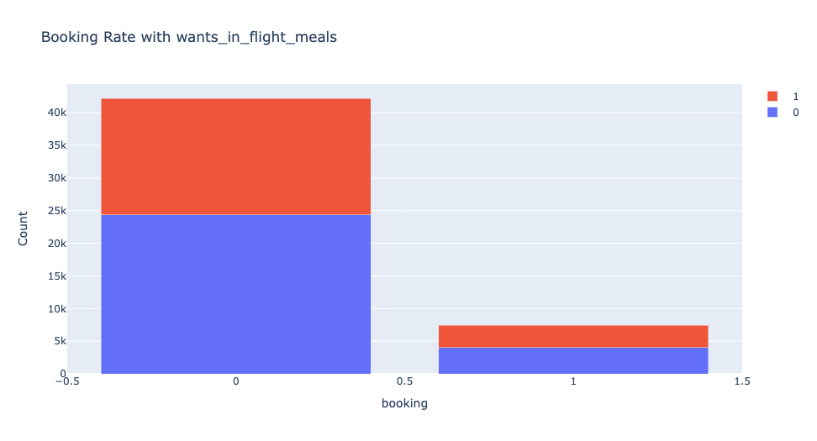
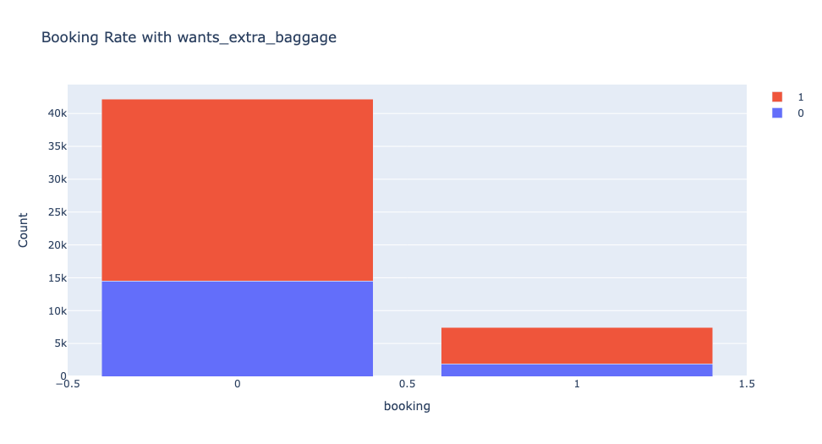
STATISTICAL SUMMARY
Insights:
Almost half of the customers wanted meals on their flights.
Almost 60% of the customers didn’t want extra baggage on their flights
Most of the customers wanted a preferred seat.

Slide 10
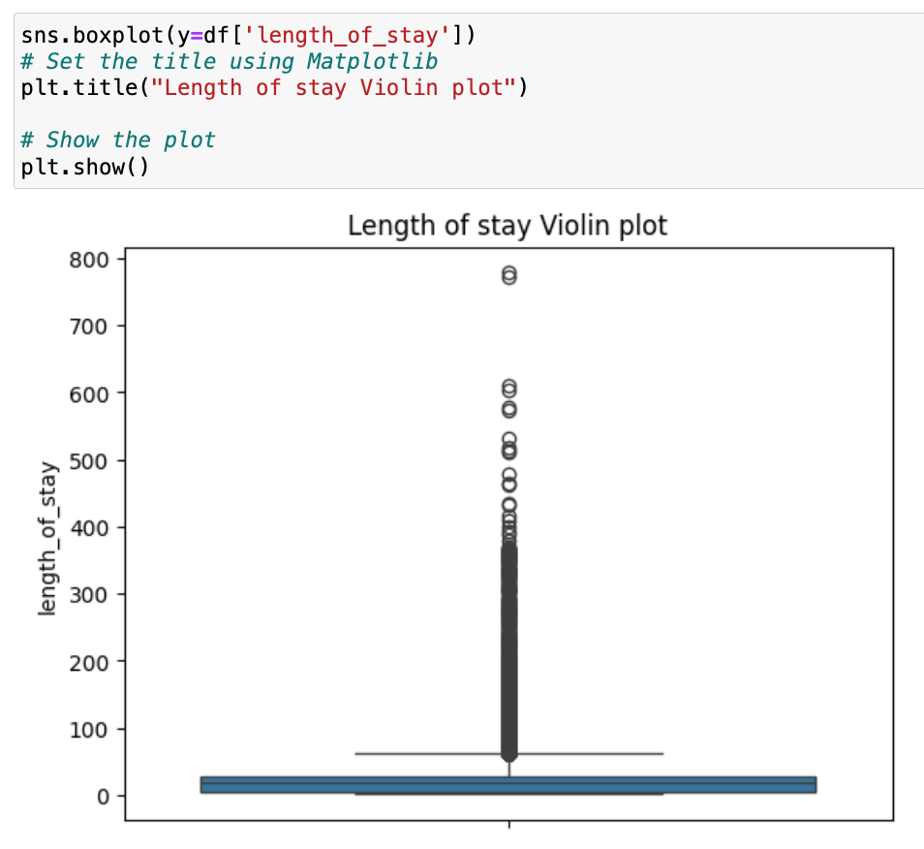
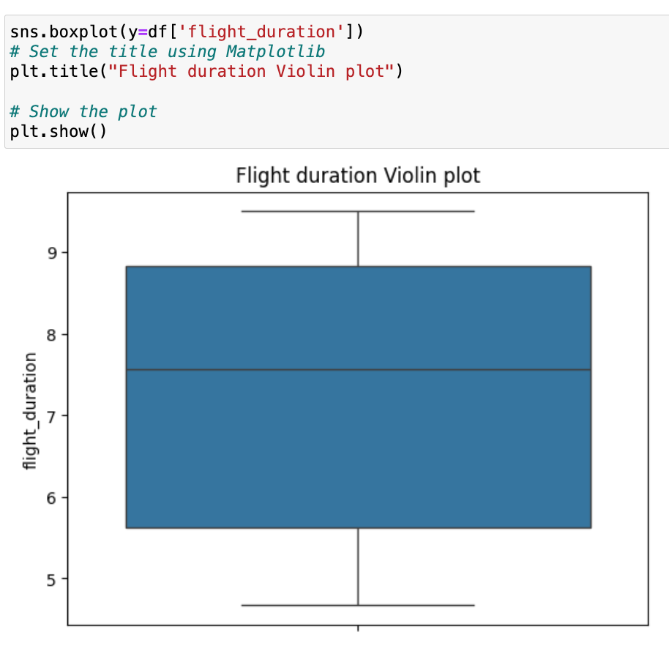
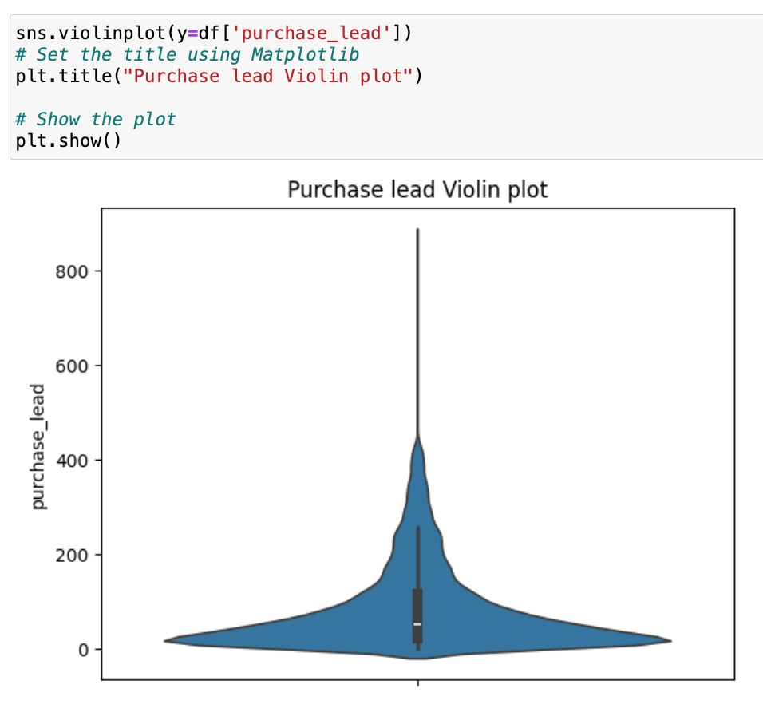
STATISTICAL SUMMARY
Insights:
The average flight duration is between 7-8 hours
The majority of Purchase Lead cost is between $100-$200 but there are some outliers.
The length of stay is normally low but there are some outliers.

Slide 11
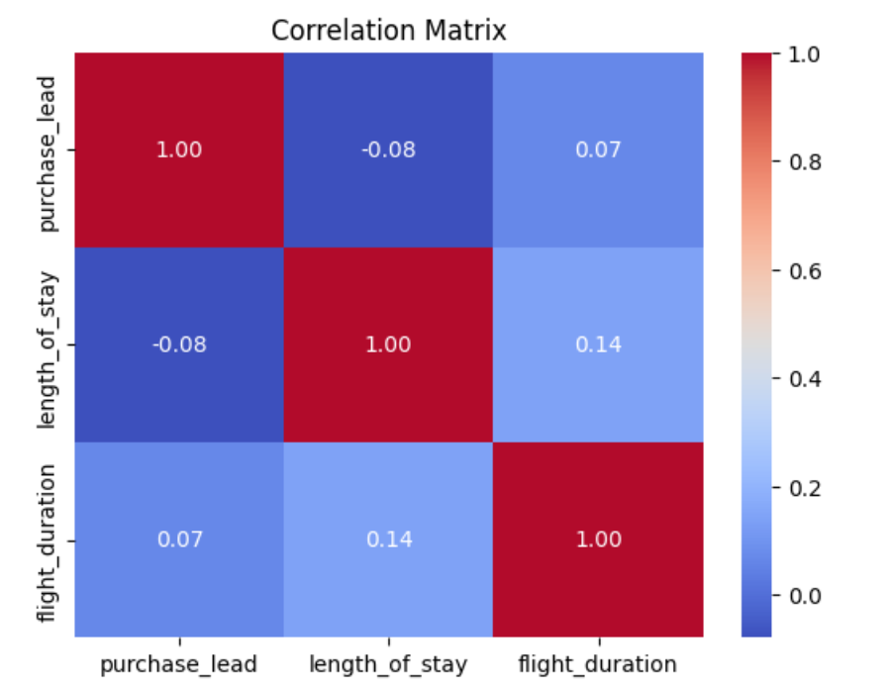
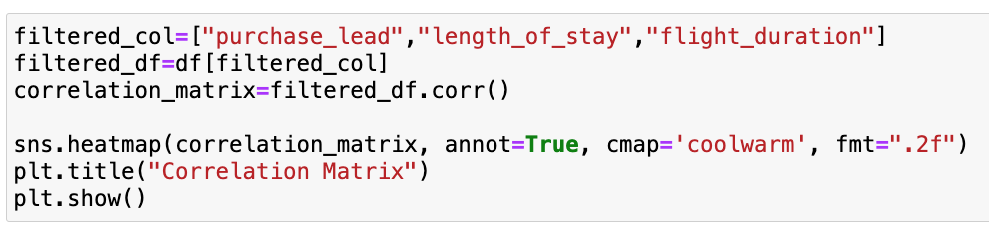
STATISTICAL SUMMARY
There is a weak correlation between the purchase lead, the length of stay and the flight duration features.

Slide 12
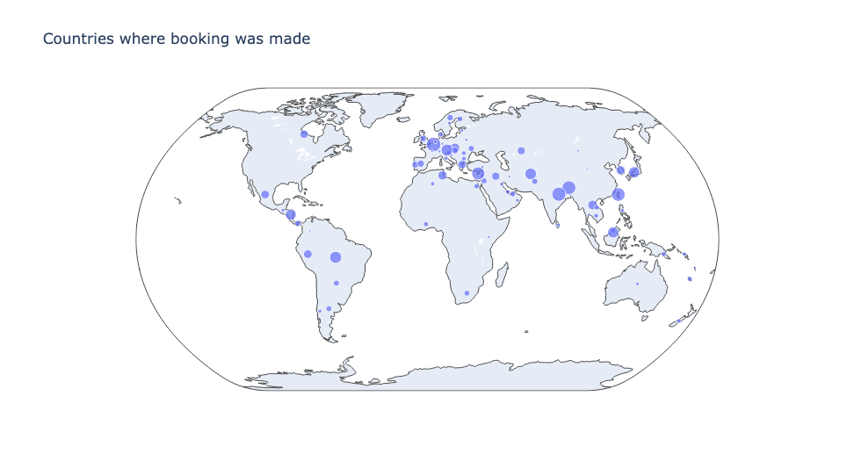
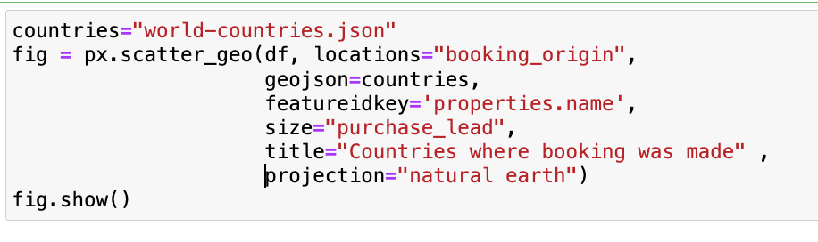
STATISTICAL SUMMARY
Insights:
Most of the bookings were made from Europe and Asia.

Slide 13
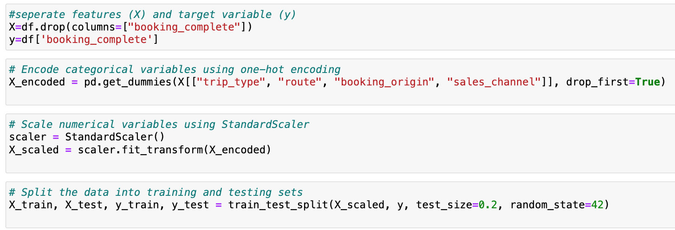
DATA TRAINING
Step:
The features were separated from the target variable into X=features and y= target variable.
The categorical features were encoded using one-hot encoding and the numerical features were scaled using the standard scaler.
The dataset was split into training and testing data for evaluation.

Slide 14
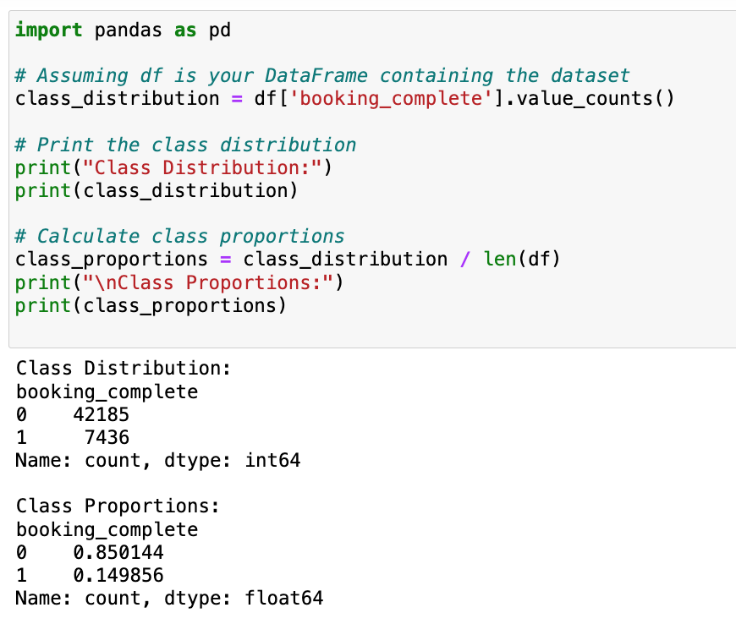
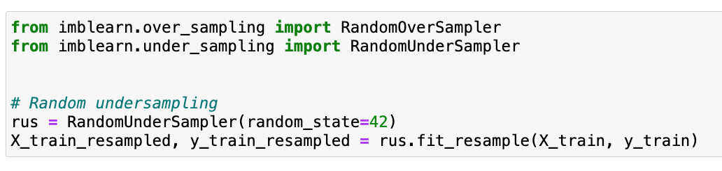
DATA TRAINING resampling
Prior to commencing data training, it was observed that the dataset exhibited class imbalance, with 80% of customers failing to complete the booking, while only 15% successfully completed it. This imbalance poses a challenge as it can hinder the effectiveness of training and prediction processes. Consequently, in order to address this issue and mitigate the dominance of the undesired outcome, random under_sampling will be employed to rebalance the dataset.

Slide 15
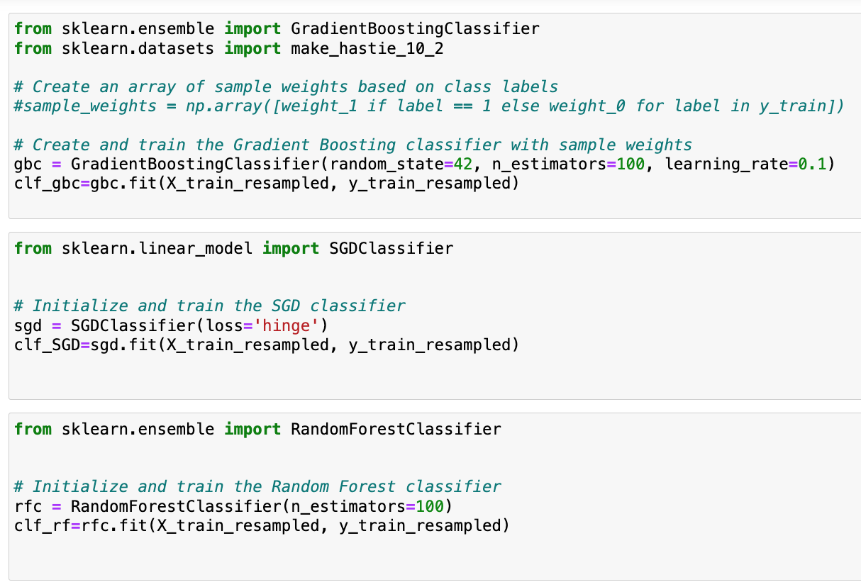
DATA TRAINING machine learning models
The models that were utilized:
1- Gradient boosting classifier:
an ensemble learning technique with random seed 42, number of weak learners is 100 to ensemble and learning rate is 0.1.
2- Stochastic Gradient Descent Classifier:
a linear classifier with loss function hinge.
3- Random Forest Classifier:
an ensemble learning method based on decision trees with 100 trees to ensemble

Slide 16
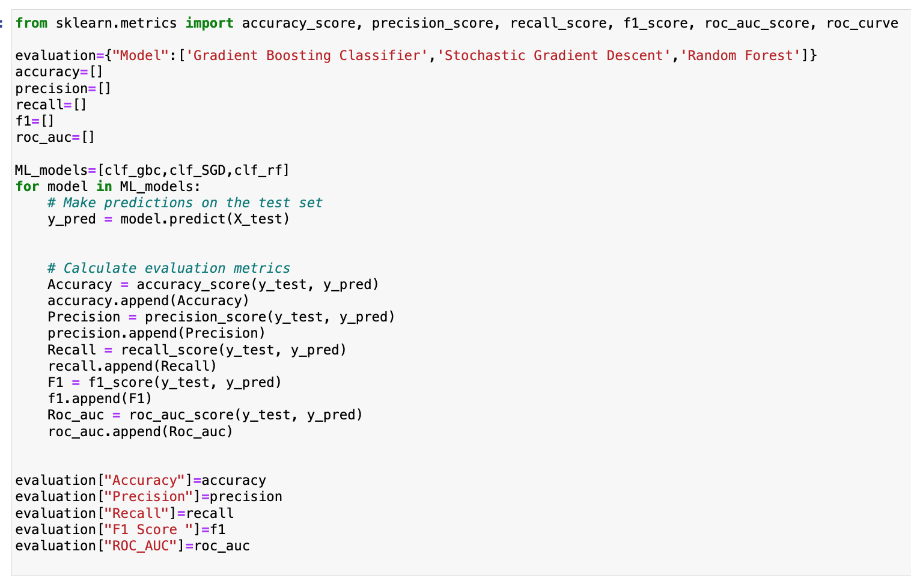
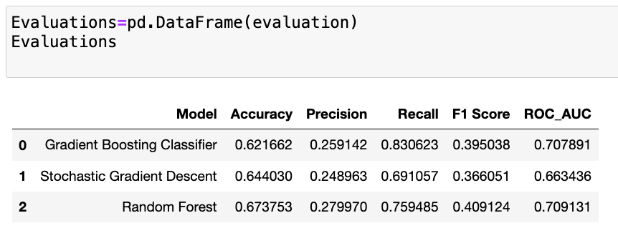
EVALUATION
The machine learning models were evaluated on a test dataset using metrics like accuracy, precision, recall, F1 score, and ROC AUC score. Random Forest outperformed others with the highest accuracy (67.38%), precision (27.99%), F1 score (40.91%), and ROC AUC (70.91%). Gradient Boosting Classifier showed the highest recall (83.06%). In summary, Random Forest generally performed better across various metrics.

Slide 17
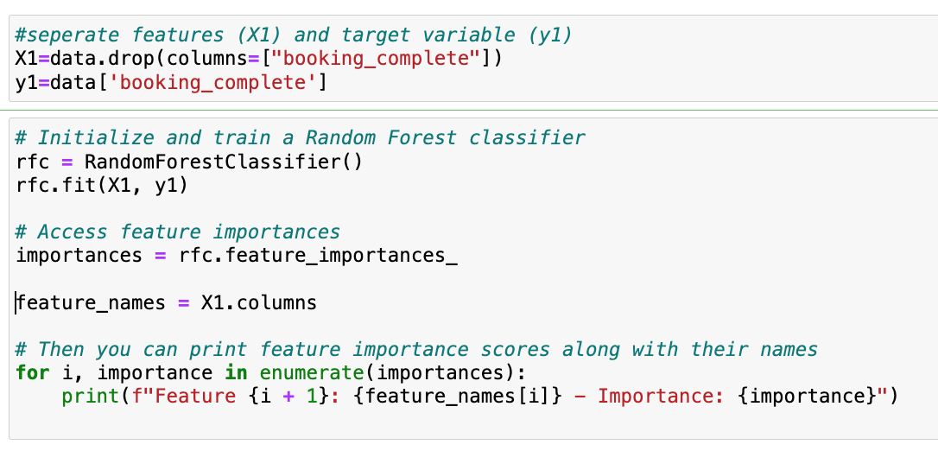
The most important feature(s)
Using random forest to provide the feature importance score which quantify the relative importance of each feature in the model’s decision making process.

Slide 18
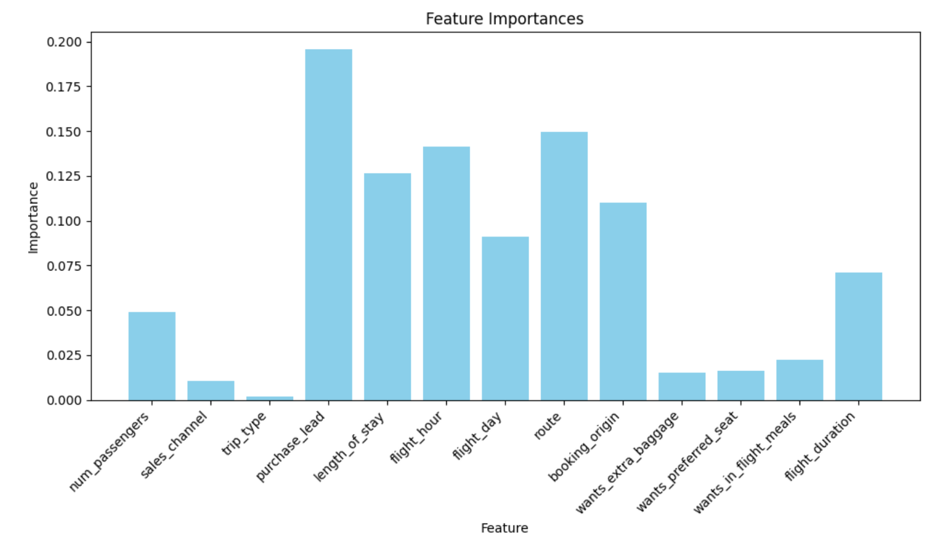
The most important feature(s)
The most important feature is purchase lead.

Slide 19
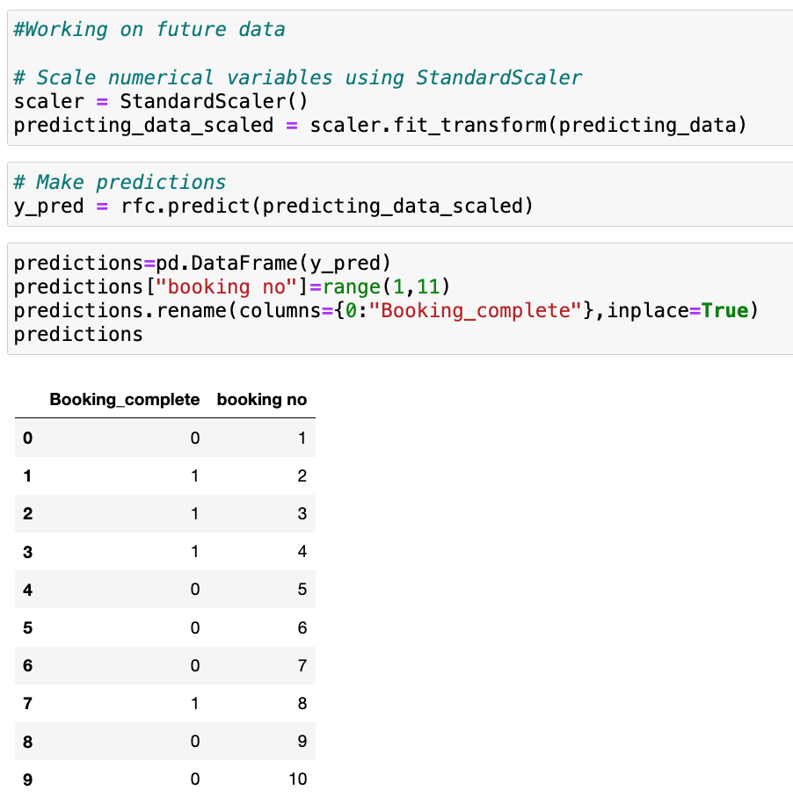
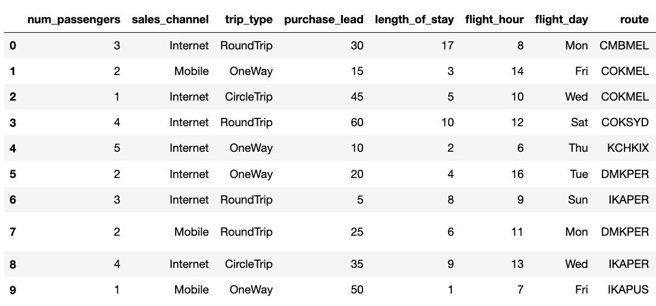
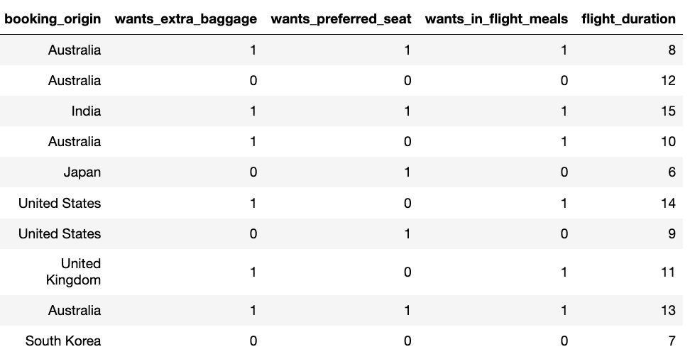
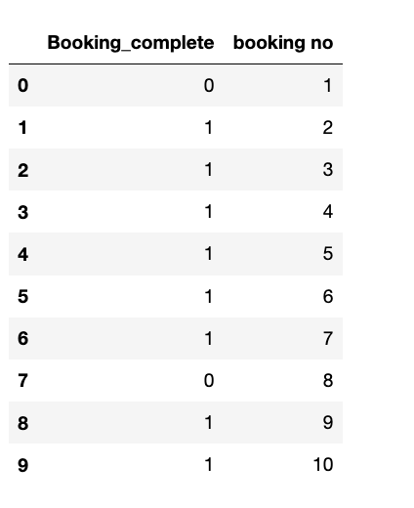
PREDICTION
10 bookings were made to be predicted, the dataset was filtered to the most important feature only (purchase lead) and the predictions were made.

Slide 20
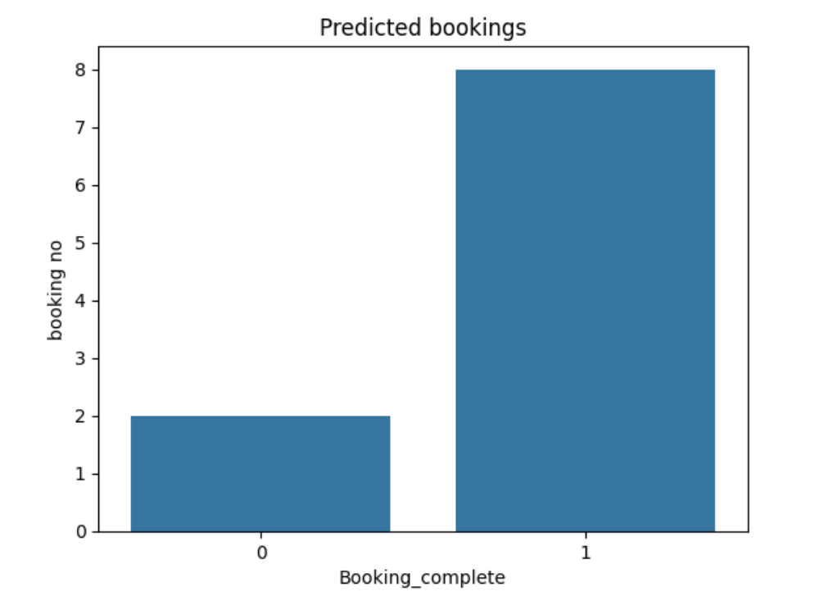
PREDICTION
6 out of 10 bookings were not complete and 4 were complete.
The booking indices that were not complete are: [0,4,5,6,8,9]

Slide 21
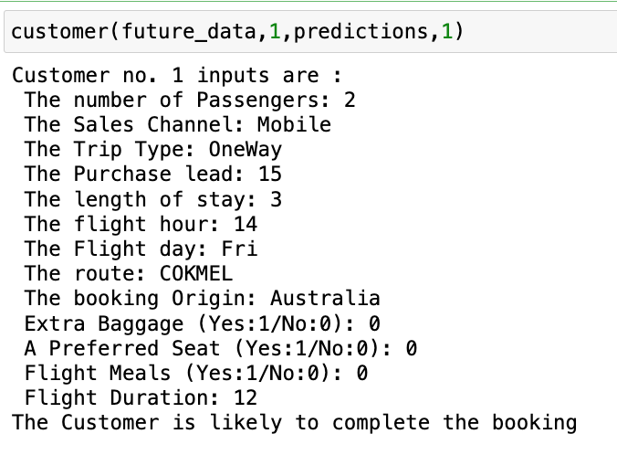
Customer input 1
The first customer information and the predicted result :

Slide 22
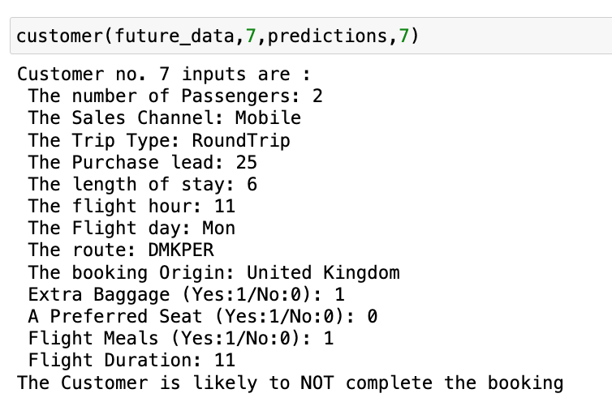
Customer input 2
The Second customer information and the predicted result :

Slide 23
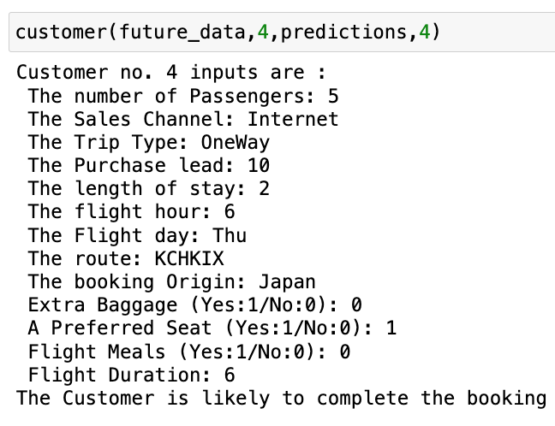
Customer input 3
The third customer information and the predicted result :

Slide 24
CONCLUSION
The aim was to apply data mining techniques to analyze customer booking behavior in a dataset from British Airways, using various machine learning models to identify key features predicting booking completion. However, the dataset was imbalanced, with incomplete bookings representing 80% of cases. To address potential bias, the dataset underwent undersampling. Models including Random Forest, Gradient Boosting Classifier (GBC), and Stochastic Gradient Descent (SGD) were trained, with Random Forest yielding the most promising results. Notably, the "Purchase Lead" feature emerged as a significant predictor of customer behavior. Subsequently, Random Forest was employed to determine the most influential features. Predictive analysis revealed that 8 out of 10 customer inputs were likely to result in completed bookings, with detailed examination of three specific cases provided.

Slide 25
Reference
Dataset:
https://www.theforage.com/virtual-experience/NjynCWzGSaWXQCxSX/british-airways/data-science-yqoz/predicting-customer-buying-behaviour
https://www.kaggle.com/datasets/minnikeswarrao/british-airways-customer-booking
Machine learning in python with scikit learn:
https://scikit-learn.org/stable/supervised_learning.html
Evaluation Metrics in Python with scikit learn:
https://scikit-learn.org/stable/modules/model_evaluation.html

